Slide 1
Scenario Clustering and
Dynamic Probabilistic Risk Assessment
Diego Mandelli
Committee members:
T. Aldemir (Advisor), A. Yilmaz (Co-Advisor),
R. Denning, U. Catalyurek
May 13th 2011, Columbus (OH)

Slide 2
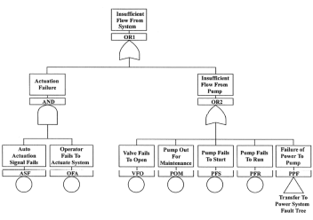
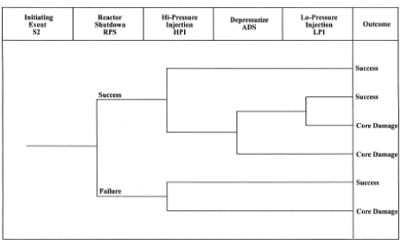
Naïve PRA: A Critical Overview
Each scenario is described by the status of particular components
Scenarios are classified into pre-defined groups
  Possible accident scenarios (chains of events)
  Consequences of these scenarios
  Likelihood of these scenarios
Station Black-out
Scenario
Post-Processing
Level 1
Level 2
Level 3
Goals
  Safety Analysis
  Results
Accident Scenario
Core Damage
Containment Breach
Effects on Population
  Risk: (consequences, probability)
  Contributors to risk

Slide 3
Naïve PRA: A Critical Overview
Weak points:
Interconnection between Level 1 and 2
Timing/Ordering of event sequences
Epistemic uncertainties
Effect of process variables on dynamics (e.g., passive systems)
“Shades of grey” between Fail and Success
Level 1
Level 2
Level 3
Accident Scenario
Core Damage
Containment Breach
Effects on Population

Slide 4
PRA in the XXI Century
  Multi-physics algorithms
“
  Human
  reliability
The Stone Age didn’t end because we ran out of stones
  Digital I&C system analysis
”
PRA mk.3
UQ and SA
  New numerical schemes
  Incorporation of System Dynamics
Classical ET/FT methodology shows the limit in this new type of analysis.
Dynamic methodologies offer a solution to these set of problems
  Dynamic Event Tree (DET)
  Markov/CCMT
  Monte-Carlo
  Dynamic Flowgraph Methodology

Slide 5
PRA in the XXI Century
Dynamic Event Trees (DETs) as a solution:
  Branch Scheduler
  System Simulator
Branching occurs when particular conditions have been reached:
Value of specific variables
Specific time instants
Plant status
Initiating Event
0
Time

Slide 6
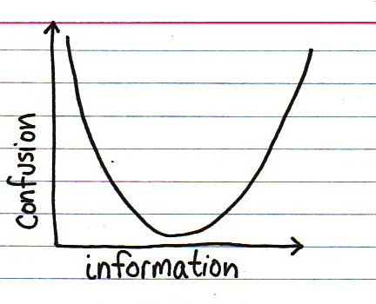
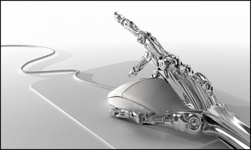
Data Analysis Applied to Safety Analysis Codes
Large number of scenarios
Difficult to organize (extract useful information)
Pre WASH-1400
“
Computing power doubles in speed every 18 months.
Data generation growth more than doubles in 18 months
NUREG-1150
”
Group the scenarios into clusters
Analyze the obtained clusters
New Generation of System Analysis Codes:
Numerical analysis (Static and Dynamic)
Modeling of Human Behavior and Digital I&C
Sensitivity Analysis/Uncertainty Quantification
Apply intelligence machine learning to a new set of algorithms and techniques to this new set of problems in a more sophisticated way to a larger data set: not 100 points but thousands, millions, …

Slide 7
In this dissertation:
We want to address the problem of data analysis through the use of clustering methodologies.
Classification
Clustering
When dealing with nuclear transients, it is possible to group the set of scenarios in two possible modes:
End State Analysis: Groups the scenarios into clusters based on the end state of the scenarios
Transient Analysis: Groups the scenarios into clusters based on their time evolution
It is possible to characterize each scenario based on:
The status of a set of components
State variables

Slide 8
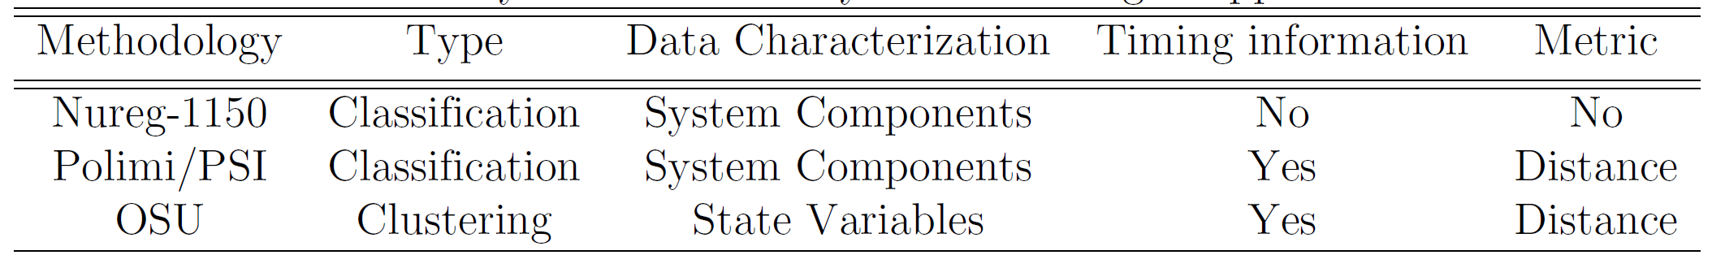
Scenario Analysis: a Historic Overview
Nureg-1150:
8 variables (e.g., status of RCS,ECCS, AC, RCP seals)
12 variables (e.g., time/size/type of cont. failure, RCS pressure pre-breach)
Scenario Variables
Level 1
Level 2
Level 3
Classes (bins)
5 classes: SBO, LOCA, transients, SGTR, Event V
5 classes: early/late/no containment failure, alpha, bypass
PoliMi/PSI: Scenario analysis through
Fuzzy Classification methodologies
component status information to characterize each scenario
A comparison:

Slide 9
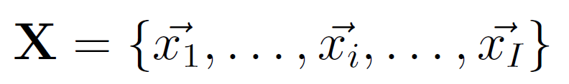
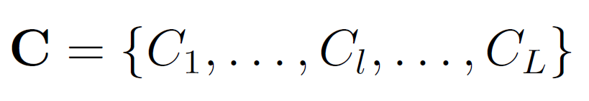
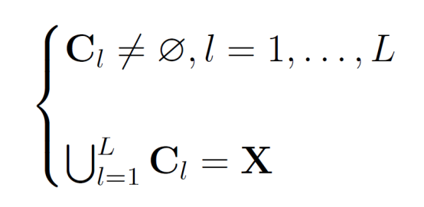
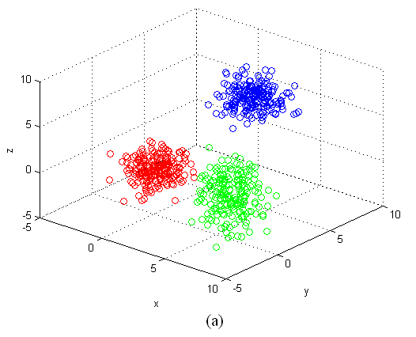
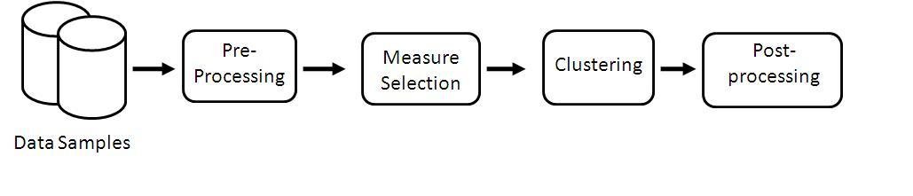
Clustering: a Definition
Given a set of I scenarios:
Clustering aims to find a partition C of X:
Such that:
Note: each scenario is allowed to belong to just one cluster
Similarity/dissimilarity criteria:
Distance based

Slide 10
An Analogy:
Y
(μ₁,σ₁²)
System
Collected
Data
(X,Y)
(μ₂,σ₂²)
X
X₁
1) Representative scenarios (μ)
X₂
time
2) How confident am I with the representative scenarios?
…
time
MELCOR
RELAP, ecc.
3) Are the representative scenarios really representative? (σ²,5th-95th)
X_{N}
time

Slide 11
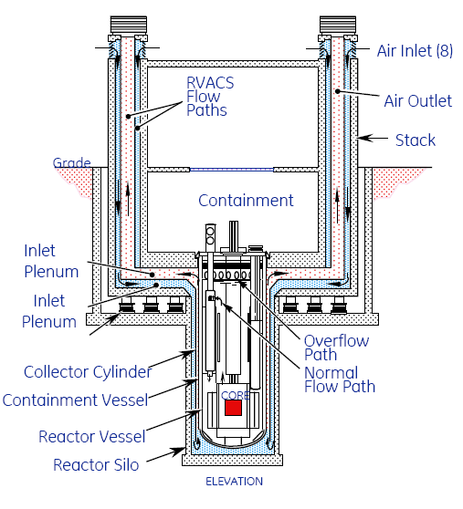
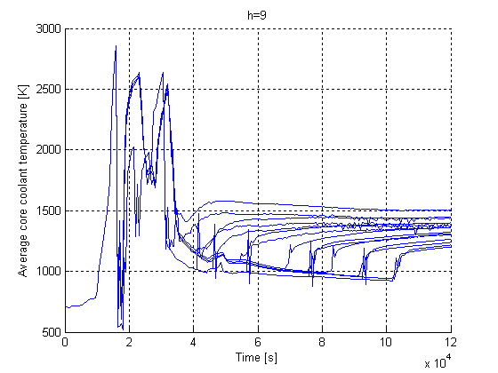
Data Analysis Applied to Safety Analysis Codes
Dataset
Data Representation
Data Normalization
Dimensionality reduction (Manifold Analysis):
  ISOMAP
  Local PCA
Pre-processing
Metric (Euclidean, Minkowsky)
Methodologies comparison:
  Hierarchical, K-Means, Fuzzy
  Mode-seeking
Parallel Implementation
Clustering
Cluster centers (i.e., representative scenarios)
Hierarchical-like data management
Applications:
Data Visualization
  Level controller
  Aircraft crash scenario (RELAP)
  Zion dataset (MELCOR)

Slide 12
Data Pre-Processing
  Each scenario is characterized by a inhomogeneous set of data:
  Large number of data channels: each data channel corresponds to a specific variable of a specific node
    These variables are different in nature: Temperature, Pressure, Level or Concentration of particular elements (e.g., H₂)
  State of components
    Discrete type of variables (ON/OFF)
    Continuous type of variables
Data Representation
Data Normalization
Subtract the mean and normalize into [0,1]
Std-Dev Normalization
Dimensionality Reduction
  Linear: Principal Component Analysis (PCA) or Multi Dimensional Scaling (MDS)
  Non Linear: ISOMAP or Local PCA
  Pre-processing of
  the data is needed

Slide 13
Scenario Representation
  How do we represent a single scenario s_{i}?
  Multiple variables
  Time evolution
  Vector in a multi-dimensional space
  M variables of interest are chosen
  Each component of this vector corresponds to the value of the variables of interest sampled at a specific time instant
  f_{im}(t)
  f_{im}(K)
  f_{im}(1)
  f_{im}(2)
  s_{i} = [ f_{im}(0) , f_{im}(1) , f_{im}(2) , … , f_{im}(K)]
  f_{im}(0)
  f_{im}(3)
Dimensionality reduction focus
  t
  Dimensionality = (number of state variables) · (number of sampling instants) = M · K

Slide 14
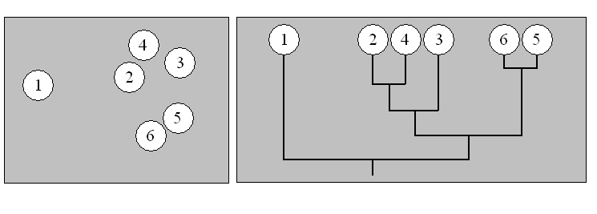
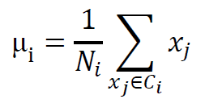
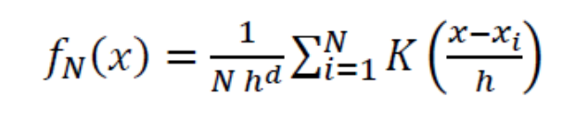
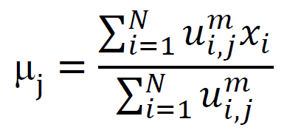
Clustering Methodologies Considered
Hierarchical
K-Means
Organize the data set into a hierarchical structure according to a proximity matrix.
Each element d(i, j) of this matrix contains the distance between the i^{th} and the j^{th} cluster center.
Provides very informative description and visualization of the data structure even for high values of dimensionality.
The goal is to partition n data points x_{i} into K clusters in which each data point maps to the cluster with the nearest mean.
K is specified by the user
Stopping criterion is to find the global minimum of the error squared function.
Cluster centers:
Fuzzy C-Means
Mean-Shift
Fuzzy C-Means is a clustering methodology that is based on fuzzy sets and it allows a data point to belong to more than one cluster.
Similar to the K-Means clustering, the objective is to find a partition of C fuzzy centers to minimize the function J.
Cluster centers:
Consider each point of the data set as an empirical distribution density function K(x)
Regions with high data density (i.e., modes) corresponds to local maxima of the global density function:
User does not specify the number of clusters but the shape of the density function K(x)

Slide 15
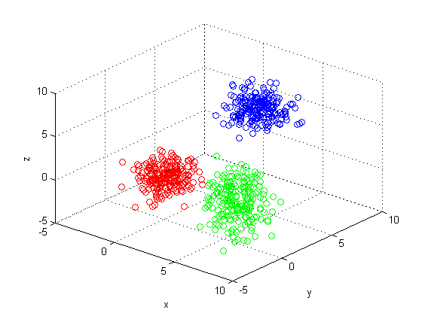
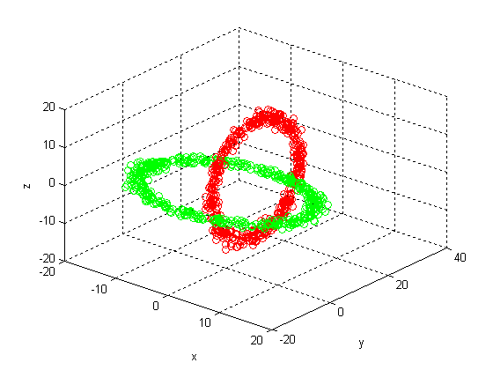
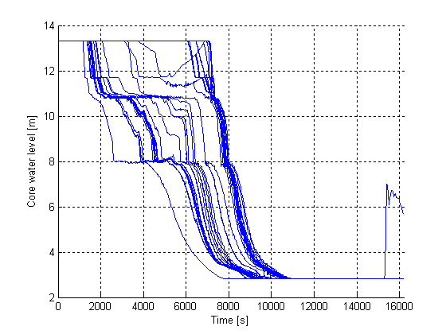
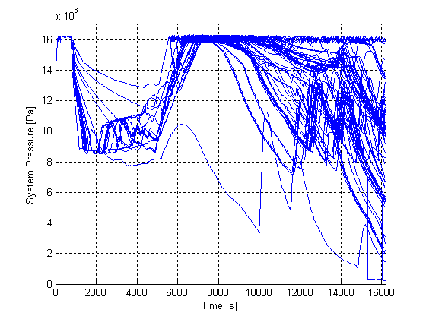
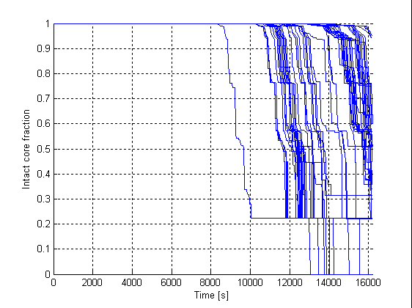
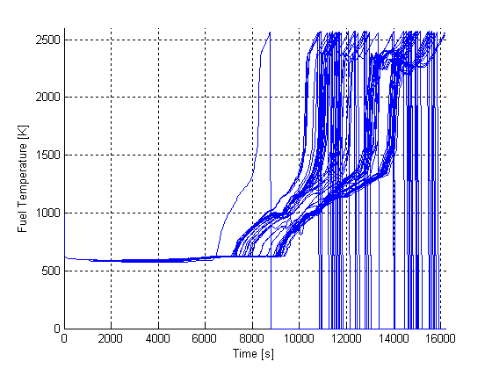
Clustering Methodologies Considered
Dataset 1
Dataset 2
300 points normally distributed in 3 groups
200 points normally distributed in 2 interconnected rings
Dataset 3
104 Scenarios generated by a DET for a Station Blackout accident (Zion RELAP Deck)
Core water level [m]: L
System Pressure [Pa]: P
Intact core fraction [%]: CF
Fuel Temperature [K]: T
4 variables chosen to represent each scenario:
Each variables has been sampled 100 times:

Slide 16
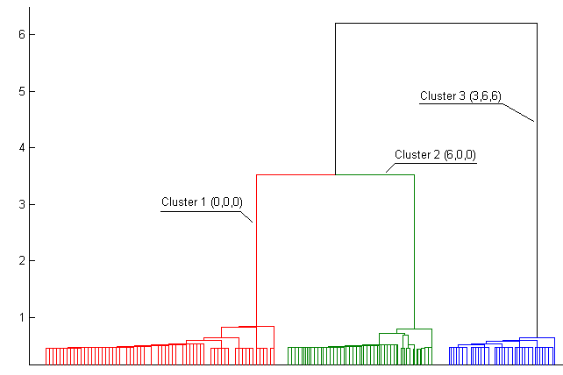
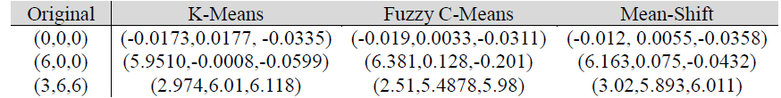

Clustering Methodologies Considered
Dataset 1
All the methodologies were able to identify the 3 clusters
Dataset 2
K- Means, Fuzzy C-Means and Hierarchical methodologies are not able to identify clusters having complex geometries
They can model clusters having ellipsoidal/spherical geometries
Mean-Shift is able to overcome this limitation

Slide 17
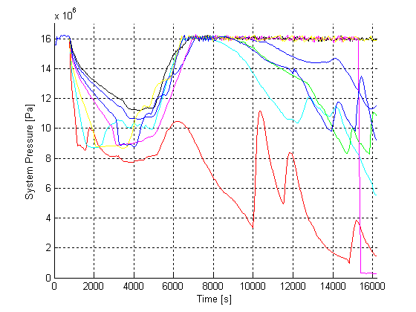
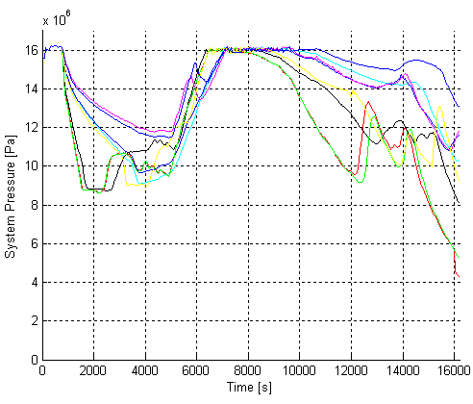
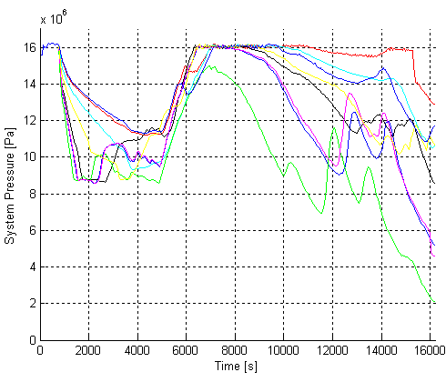
Clustering Methodologies Considered
In order to visualize differences we plot the cluster centers on 1 variable (System Pressure)
Mean-Shift K- Means Fuzzy C-Means

Slide 18


Clustering Methodologies Considered
Clustering algorithm requirements:
  Geometry of clusters
  Outliers (clusters with just few points)
  Hierarchical
  K-Means
  Fuzzy C-Means
  Mean Shift
Methodology implementation
  Algorithm developed in Matlab
  Pre-processing + Clustering

Slide 19

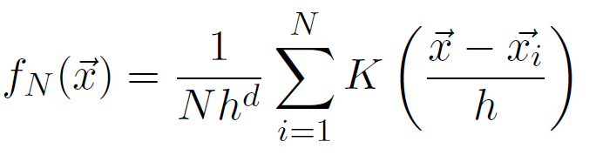
Mean-Shift Algorithm
  Consider each point of the data set as an empirical distribution density function distributed in a d-dimensional space
  Consider the global distribution function :
Bandwidth (h)
  Regions with high data density (i.e., modes) correspond to local maxima of the global probability density function :
Cluster centers: Representative points for each cluster ( )
Bandwidth: Indicates the confidence degree on each cluster center

Slide 20


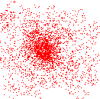
Algorithm Implementation
Objective: find the modes in a set of data samples
Scalar
(Density Estimate)
Vector
(Mean Shift)
= 0 for isolated points
= 0 for local maxima/minima

Slide 21
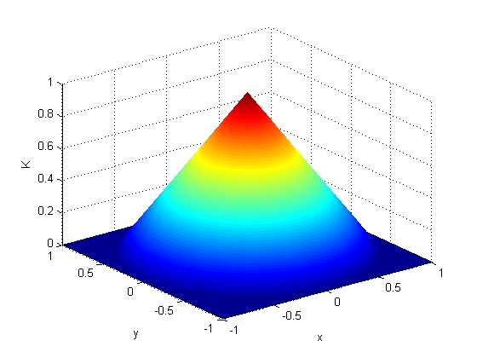
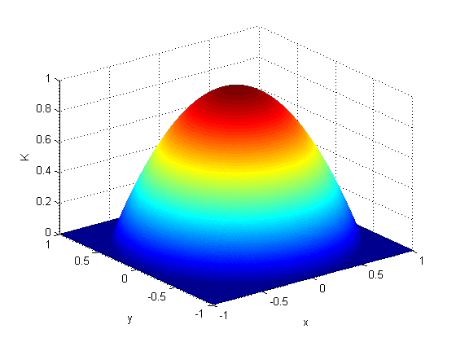
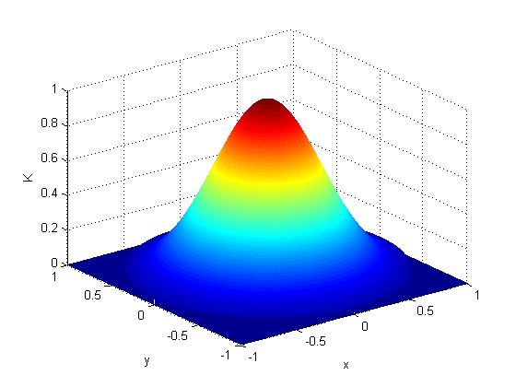
Bandwidth and Kernels
Choice of Bandwidth:
Case 1: h very small
12 points
12 local maxima (12 clusters)
Case 2: h intermediate
12 points
3 local maxima (3 clusters)
Case 3: h very large
12 points
1 local maxima (1cluster)
Choice of Kernels

Slide 22
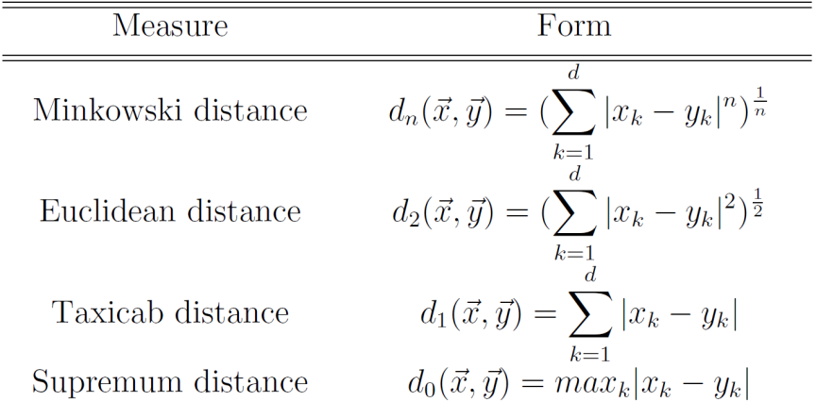
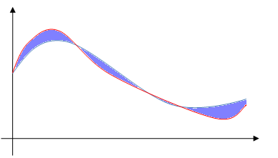
Measures
Physical meaning of distances between scenarios
  x_{d}
Type of measures:
  x₂
  y_{d}
  y₂
  x₃
  y₄
  y₁,x₁
  y₃
  x₄
  t
  x = [ x₁, x₂ , x₃, x₄, … , x_{d}]
  y = [ y₁, y₂ , y₃, y₄, … , y_{d}]
  t
  t

Slide 23
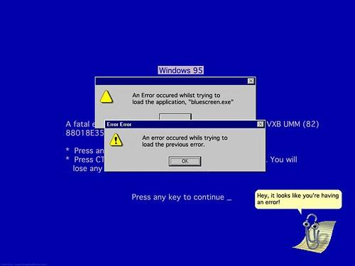

Slide 24
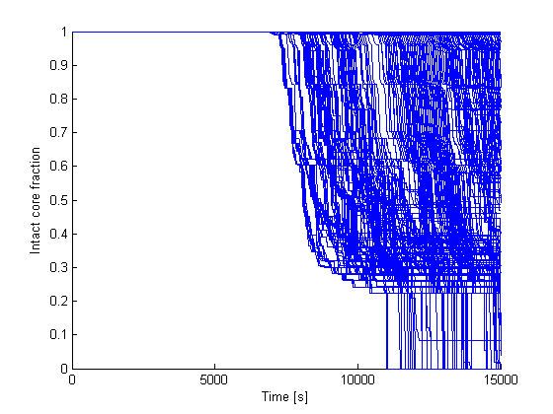
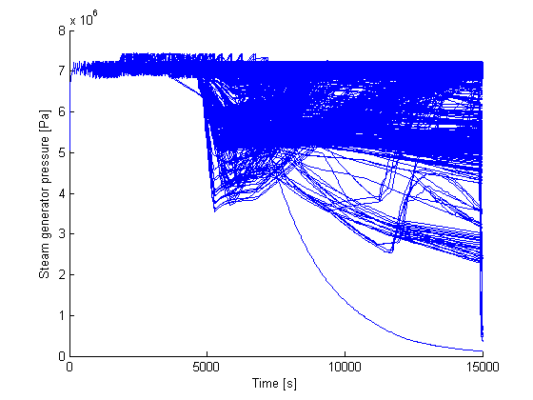
Zion Station Blackout Scenario
  Zion Data set: Station Blackout of a PWR (Melcor model)
  Original Data Set: 2225 scenarios (844 GB)
  Analyzed Data set (about 400 MB):
  2225 scenarios
  22 state variables
  Scenarios Probabilities
  Components status
  Branching Timing

Slide 25
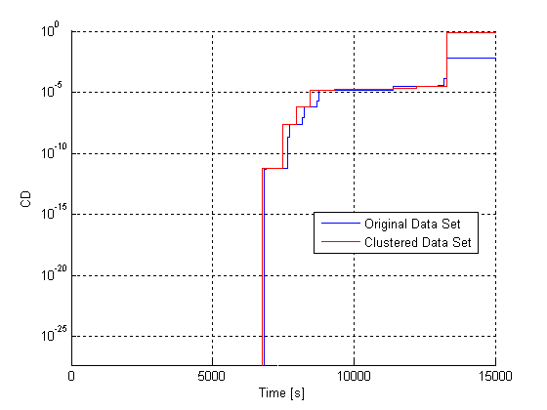
Zion Station Blackout Scenario
h | # of Cluster Centers
40 | 1
30 | 2
25 | 6
20 | 19
15 | 32
0.1 | 2225
  Analysis performed for different values of bandwidth h:
“
”
  Which value of h to use?
  Need of a metric of comparison between the original and the clustered data sets
  We compared the conditional probability of core damage for the 2 data sets

Slide 26
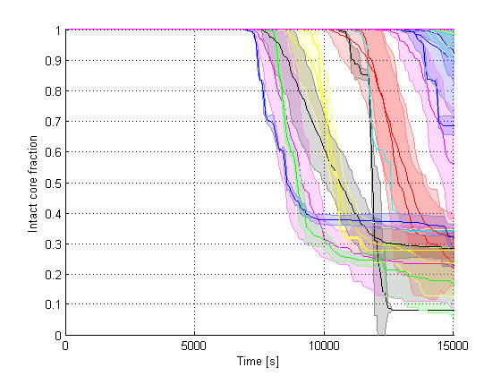
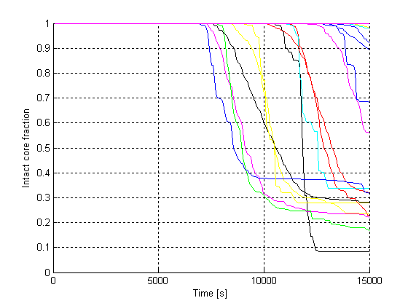
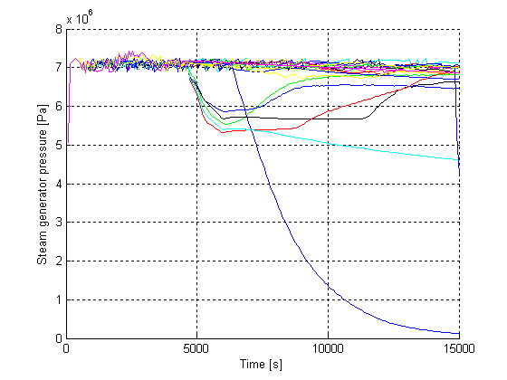
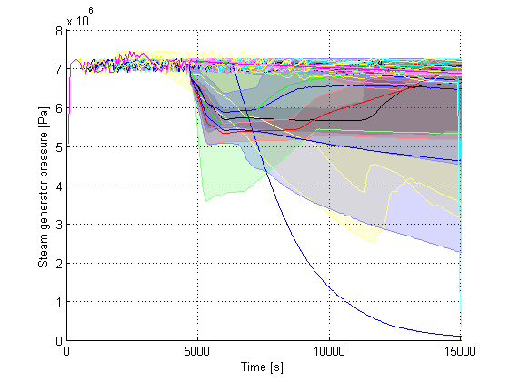
Zion Station Blackout Scenario
“
  Cluster Centers and Representative Scenarios
”
Y
(μ₁,σ₁²)
(μ₂,σ₂²)
X

Slide 27
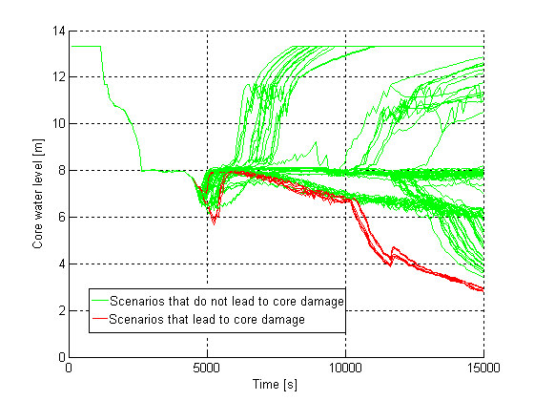
Zion Station Blackout Scenario
Cluster | # Scenarios | # Scenarios that lead to CD
1 | 132 | 98
2 | 321 | 28
3 | 24 | 24
4 | 631 | 0
5 | 27 | 0
6 | 6 | 6
7 | 43 | 43
8 | 3 | 3
9 | 5 | 5
10 | 108 | 108
11 | 150 | 150
12 | 44 | 44
13 | 304 | 147
14 | 75 | 75
15 | 124 | 124
16 | 127 | 7
17 | 63 | 63
18 | 12 | 12
19 | 26 | 0
Cluster | # Scenarios | # Scenarios that lead to CD
1 | 132 | 98
2 | 321 | 28
13 | 304 | 147
16 | 127 | 7
  Starting point to evaluate “Near Misses” or scenarios that did not lead to CD because mission time ended before reaching CD

Slide 28
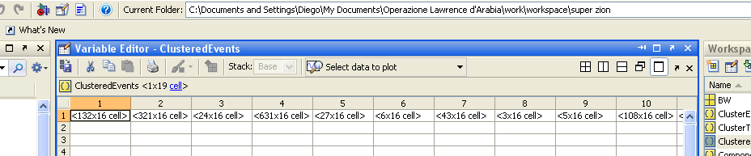
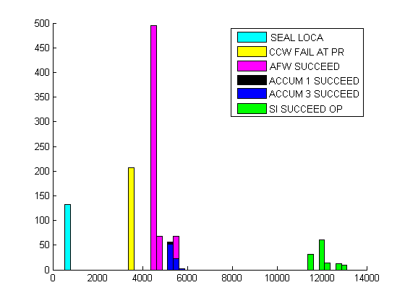
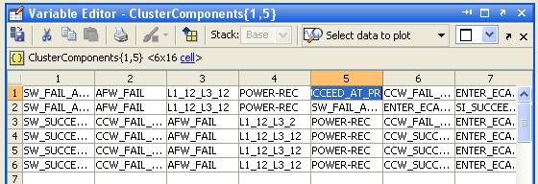
Zion Station Blackout Scenario
  Components analysis performed in a hierarchical fashion
    Each cluster retains information on all the details for all scenarios contained in it (e.g. event sequences, timing of events)
    Efficient data retrieval and data visualization needs further work

Slide 29
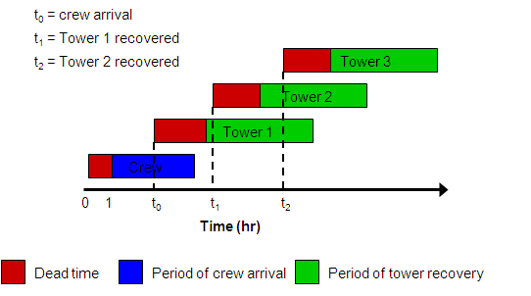
Aircraft Crash Scenario
Aircraft Crash Scenario (reactor trips, offsite power is lost, pump trips)
3 out of 4 towers destroyed, producing debris that blocks the air passages (decay heat removal impeded)
Scope: evaluate uncertainty in crew arrival and tower recovery using DET
A recovery crew and heavy equipment are used to remove the debris.
Strategy that is followed by the crew in reestablishing the capability of the RVACS to remove the decay heat

Slide 30
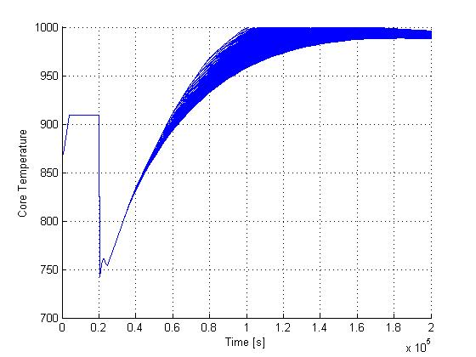
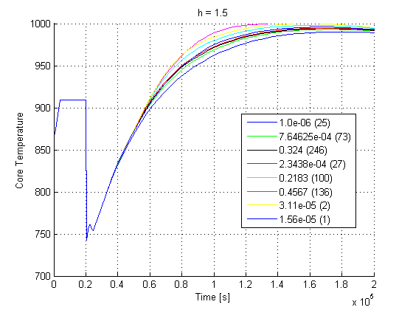
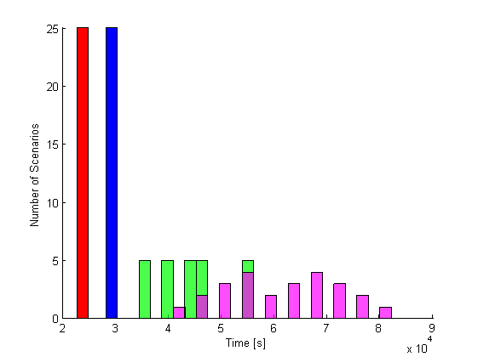


Aircraft Crash Scenario
Legend:
Crew arrival
1st tower recovery
2nd tower recovery
3rd tower recovery

Slide 31

Parallel Implementation
  Motives:
  Long computational time (orders of hours)
  In vision of large data sets (order of GB)
  Clustering performed for different value of bandwidth h
  Develop clustering algorithms able to perform parallel computing
  Machines:
  Single processor, Multi-core
  Multi processor (cluster), Multi-core
  Languages:
  Matlab (Parallel Computing Toolbox)
  C++ (OpenMP)
  Rewriting algorithm:
  Divide the algorithms into parallel and serial regions
  Source: LLNL

Slide 32


Parallel Implementation Results
  Machine used:
  CPU: Intel Core 2 Quad 2.4 GHz
  Ram 4 GB
  Tests:
  Data set 1: 60 MB (104 scenarios, 4 variables)
  Data set 2: 400 MB (2225 scenarios, 22 variables)

Slide 33


Dimensionality Reduction
  System simulator (e.g. PWR)
  Thousands of nodes
  Temperature, Pressure, Level in each node
  Locally high correlated (conservation or state equations)
  Correlation fades for variables of distant nodes
  Problem:
  Choice of a set of variables that can represent each scenario
  Can I reduce it in order to decrease the computational time?
  Manifold learning for dimensionality reduction: find bijective mapping function
  ℑ: X⊂ℝ^{D}↦ Y⊂ℝ^{d} (d ≤ D)
  where:
  D: set of state variables plus time
  d: set of reduced variables

Slide 34
Dimensionality Reduction
  Manifold learning for dimensionality reduction: find bijective mapping function
  ℑ: X⊂ℝ^{D}↦ Y⊂ℝ^{d} (d ≤ D)
  where:
  D: set of state variables plus time
  d: set of reduced variables
  1- Principal Component Analysis (PCA): Eigenvalue/Eigenvector decomposition of the data covariance matrix
y
After Projection on 1st Principal component
1st Principal Component (𝜆₁)
2nd Principal Component (𝜆₂ < 𝜆₁)
x
  2- Multidimensional Scaling (MDS): find a set of dimensions that preserve distances among points
  Create dissimilarity matrix D=[d_{ij}] where d_{ij}=distance(i,j)
  Find the hyper-plane that preserves “nearness” of points
  PCA
  MDS
  Local PCA
  ISOMAP
  Linear Non-Linear

Slide 35
Dimensionality Reduction
Non-linear Manifolds: Think Globally, Fit Locally
  Local PCA: Partition the data set and perform PCA on each subset
After Projection on 1st Principal component
y
y
t
t
  ISOMAP: Locally implementation of MDS through Geodesic distance:
  Connect each point to its k nearest neighbors to form a graph
  Determine geodesic distances (shortest path) using Floyd’s or Dijkstra’s algorithms on this graph
  Apply MDS to the geodesic distance matrix
Geodesic
Rome
New York
Euclidean

Slide 36


Dimensionality Reduction Results: ISOMAP
  Procedure
  Perform dimensionality reduction using ISOMAP to the full data set
  Perform clustering on the original and the reduced data sets: find the cluster centers
  Identify the scenario closest to each cluster center (medoid)
  Compare obtained medoids for both data sets (original and reduced)
  Manifold learning for dimensionality reduction: find bijective mapping function
  ℑ: X⊂ℝ^{D}↦ Y⊂ℝ^{d} (d ≤ D)
  ℑ
  ℝ^{D}
  X
  Y
  ℝ^{d}
  ℑ⁻¹
  Results: reduction from D=9 to d=6

Slide 37



Dimensionality Reduction Results: Local PCA
  Procedure
  Perform dimensionality reduction using Local PCA to the full data set
  Perform clustering on the original and the reduced data sets: find the cluster centers
  Transform the cluster centers obtained from the reduced data set back to the original space
  Compare obtained cluster centers for both data sets
  Preliminary results: reduction from D=9 to d=7
  Manifold learning for dimensionality reduction: find bijective mapping function
  ℑ: X⊂ℝ^{D}↦ Y⊂ℝ^{d} (d ≤ D)
  ℑ
  ℝ^{D}
  X
  Y
  ℝ^{d}
  ℑ⁻¹

Slide 38
Conclusions and Future Research
  Scope: Need for tools able to analyze large quantities of data generated by safety analysis codes
  This dissertation describes a tool able to perform this analysis using cluster algorithms:
  Algorithms evaluated:
  Hierarchical, K-Means, Fuzzy
  Mode-seeking
Comparison between clustering algorithms and Nureg-1150 classification
  Data sets analyzed using Mean-Shift algorithm:
  Clusters center are obtained
  Analysis performed on each cluster separately
Analysis of data sets which include information of level 1, 2 and 3 PRA
Incorporate clustering algorithms into DET codes
  Algorithm implementation:
  Parallel implementation
Comparison between clustering algorithms and Nureg-1150 classification
  Data processing pre-clustering:
  Dimensionality reduction: ISOMAP and Local PCA

Slide 39
  Thank you for your attention, ideas, support and…
  …for all the fun :-P

Slide 40
Data Analysis Applied to Safety Analysis Codes
Dataset
Data Normalization
Dimensionality reduction (Manifold Analysis):
  ISOMAP
  Local PCA
Principal Component Analysis (PCA)
Pre-processing
Metric (Euclidean, Minkowsky)
Methodologies comparison:
  Hierarchical, K-Means, Fuzzy
  Mode-seeking
Parallel Implementation
Clustering
Cluster centers (i.e., representative scenarios)
Hierarchical-like data management
Applications:
Data Visualization
  Level controller
  Aircraft crash scenario (RELAP)
  Zion dataset (MELCOR)

